Slide 1

Climate Wins: Machine Learning for Climate Prediction
The presentation focuses on leveraging machine learning to enhance climate forecasting and enable data-driven decision-making. This initiative aims to improve our understanding of climate trends, identify weather anomalies, and ultimately support effective climate action planning. By utilizing diverse data sources and advanced analytical methods, we strive to provide policymakers and stakeholders with actionable insights for a sustainable future. The presentation will cover the data used, the machine learning methods applied, the outcomes achieved, and recommendations for future work.
by Timothy Aluko

Slide 2
Diverse Data Sources for Comprehensive Analysis
Historical Weather Data
Satellite and Radar Imagery
Real-time Weather Station Data
Topographical and Climate Zone Data
Utilizing extensive historical records of temperature, precipitation, and extreme weather events to identify long-term climate trends and patterns.
Employing visual data from satellites and radar systems to provide crucial insights for deep learning models, aiding in the detection of deforestation and glacial melting.
Integrating continuous data streams from weather stations to ensure models are up-to-date and forecasts are highly accurate, reflecting current climate conditions.
Incorporating geographical information to understand how topography and climate zones influence regional climate trends and weather patterns.

Slide 3




Advanced Machine Learning Methods for Climate Insights
Random Forest
Applying Random Forest models to pinpoint key climate trends and understand the correlation between various weather conditions, enhancing predictive accuracy.
CNNs (Deep Learning)
Employing Convolutional Neural Networks to analyze satellite imagery, enabling the detection of critical environmental changes such as deforestation and glacial melting.
GANs (Generative Adversarial Networks)
Using Generative Adversarial Networks to simulate potential future climate scenarios, allowing for the assessment of a wide range of climate variations and impacts.

Slide 4

Data Cleaning, Preprocessing, and Visualization
Data Cleaning & Preprocessing
Clustering Analysis
Employing hierarchical clustering techniques, such as Ward & Complete Method, to effectively group and analyze complex climate patterns, revealing underlying structures.
Implementing rigorous data refinement and structuring processes using Python, ensuring high-quality datasets for accurate model training and analysis.
Visualization & Trend Analysis
Leveraging Power BI dashboards for interactive data representation and employing ensemble models to detect and analyze anomalies, providing clear, actionable insights.

Slide 5
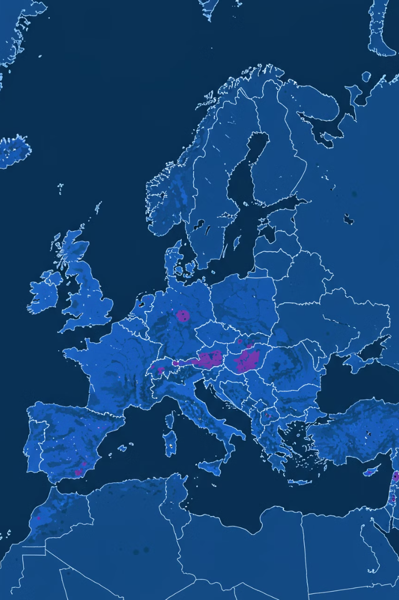
Enhanced Climate Visibility and Trend Identification
1
Extreme Weather Trends
2
Model Accuracy Improvement
Identified significant trends in extreme weather conditions across various European regions, providing critical information for localized climate action planning.
Achieved a 0.67% increase in model accuracy through rigorous optimization, effectively reducing overfitting and prioritizing the most influential features.
3
Safest European Cities
Highlighted the safest European cities based on comprehensive future climate projections, offering valuable insights for urban planning and risk management.

Slide 6



Data-Driven Decision Making for Effective Climate Action
Risk Assessment Tools
Provided advanced tools for climate risk assessment, empowering stakeholders to proactively identify and mitigate potential threats.
ML-Integrated Policymaking
2
Enabled policymakers to seamlessly integrate machine learning outputs into climate action planning, fostering evidence-based strategies.
1
Anomaly Prediction Accuracy
Achieved 97.7% accuracy in predicting weather anomalies using GANs, enhancing preparedness and response capabilities.
3

Slide 7
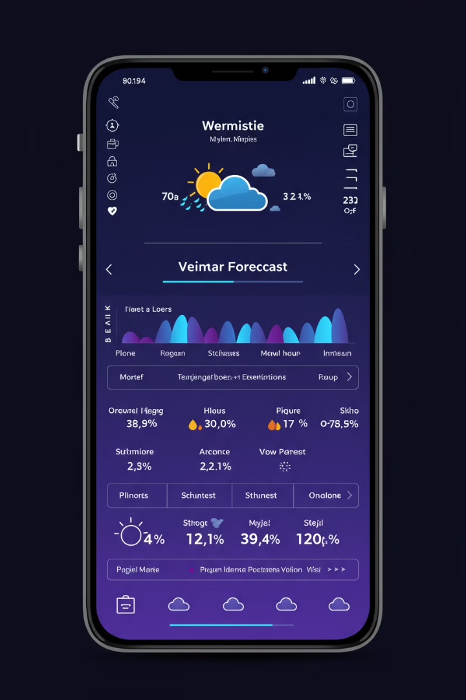
Improved Forecasting Accuracy and Model Refinement
1
High Prediction Accuracy
Achieved 97.7% accuracy in predicting weather anomalies using GANs, significantly enhancing forecasting capabilities.
2
Reduced Misclassification
Reduced misclassification of cloudy conditions through refined training datasets, leading to more reliable and precise weather predictions.

Slide 8

Future Potential & Recommendations
To maximize the impact of machine learning in climate prediction, we recommend a three-step progression:
Hybrid Systems Integration
1
Combining physics-based models with machine learning for enhanced prediction accuracy
Global Data Collaboration
2
Expanding data sharing across regions to improve model generalizability
Sustainable AI Implementation
3
Optimizing computational efficiency for eco-friendly model training
These strategic steps will help create more precise, broadly applicable, and environmentally conscious climate prediction systems.

